Slide 1
Software Engineering COMP 201
Lecturer: Sebastian Coope
Ashton Building, Room G.18
E-mail: coopes@liverpool.ac.uk
COMP 201 web-page:
http://www.csc.liv.ac.uk/~coopes/comp201
Lecture 10 – System Models

Slide 2
Introduction
Today we shall consider several system models:
Mealy machines
Moore machines
Petri Nets
UML diagrams.
Each of these can be used for specifying parts of the system and analysing properties.
When you see a new model, ask yourself what type of properties that model could potentially represent.

Slide 3
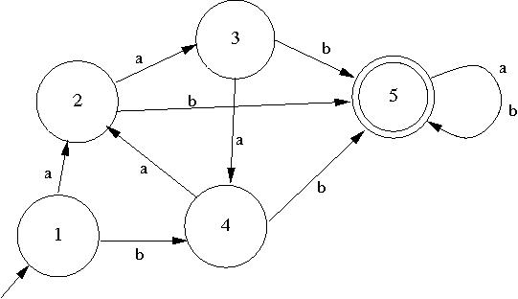
Finite State Machines - Recap
A model of computation consisting of
a set of states,
a start state,
an input alphabet, and
a transition function that maps input symbols
and current states to a next state
What language is recognised by this FSA?

Slide 4
Finite State Machines - Recap
Computation begins in the start state with an input string. It changes to new states depending on the transition function.
states define behaviour and may produce actions
state transitions are movement from one state to another
rules or conditions must be met to allow a state transition
input events are either externally
or internally generated, which
may possibly trigger rules and
lead to state transitions.

Slide 5
Variants of FSMs
There are many variants, for instance,
machines having actions (outputs) associated with transitions (Mealy machine) or states (Moore machine),
multiple start states,
transitions conditioned on no input symbol (a null) or more than one transition for a given symbol and state (nondeterministic finite state machine),
one or more states designated as accepting states (recognizer), etc.

Slide 6
Application of FSM with acceptance state
Spellchecker (can be used for predictive tests as well)
The FSM in this case will be a tree structure
A
B
1
C
2
A
3
T
4

Slide 7
Application of FSM predictive test
Each path to an acceptance state from the current path can be a word suggestion or prediction
This FSM can recognise ALP ALPINE and ALLIGATOR
1
A
2
L
3
4
5
6
L
I
G
P
A
11
7
I
T
12
N
10
9
8
R
O
13
14
E

Slide 8
Finite State Machines with Output (Mealy and Moore Machines)
Finite state automata are like computers in that they receive input and process the input by changing states.
The only output that we have seen finite automata produce so far is a yes/no at the end of processing.
We will now look at two models of finite automata that produce more output than a yes/no.

Slide 9
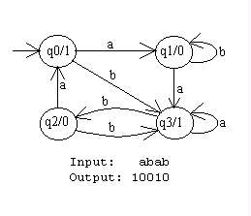
Moore Machine
Basically a Moore machine is just a FSA with two extra attributes.
1. It has TWO alphabets, an input and output alphabet.
2. It has an output letter associated with each state. The machine writes the appropriate output letter as it enters each state.

Slide 10
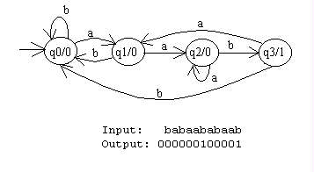
Example - Moore Machine
This machine might be considered as a "counting" machine.
The output produced by the machine contains a 1 for each occurrence of the substring aab found in the input string.

Slide 11
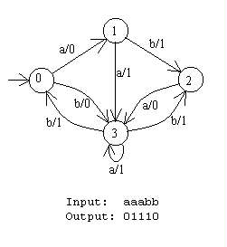
Mealy Machine
Mealy machines are computationally equivalent to Moore machines
(we can implement any Mealy machine using a Moore machine, and vice versa).
However, Mealy machines move the output function from the state to the transition. This turns out to be easier to deal with in practice, making Mealy machines more practical.

Slide 12
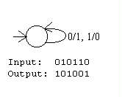
A Mealy Machine Produces Output on a Transition
Transitions are labelled i/o where
i is a character in the input alphabet and
o is a character in the output alphabet.
The following Mealy machine takes the one's complement of its binary input. In other words, it flips each digit from a 0 to a 1 or from a 1 to a 0.

Slide 13
A Mealy Machine Produces Output on a Transition
Mealy machines are complete in the sense that there is a transition for each character in the input alphabet leaving every state.
There are no accept states in a Mealy machine because it is not a language recogniser, it is an output producer. Its output will be the same length as its input.

Slide 14
Petri Net Models
Petri Nets were developed originally by Carl Adam Petri (when he was 12), and were the subject of his dissertation in 1962.
Originally to model chemical reactions
Since then, Petri Nets and their concepts have been extended, developed, and applied in a variety of areas.
While the mathematical properties of Petri Nets are interesting and useful, the beginner will find that a good approach is to learn to model systems by constructing them graphically.

Slide 15
The Basics
A Petri Net is a collection of directed arcs connecting places and transitions.
Places may hold tokens.
The state or marking of a net is its assignment of tokens to places.
Place with token
P1
Arc with capacity 1
T1
Place
Transition
P2

Slide 16
Capacity
Arcs have capacity 1 by default; if other than 1, the capacity is marked on the arc, or else we use multiple arrows to denote the capacity (i.e. 5 arrows for capacity 5).
Places have infinite capacity by default.
Transitions have no capacity, and cannot store tokens at all.
Arcs can only connect places to transitions and vice versa.
A few other features and considerations will be added as we need them.

Slide 17
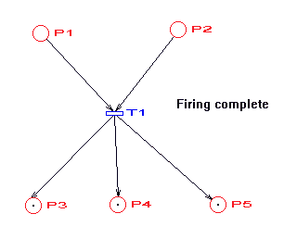
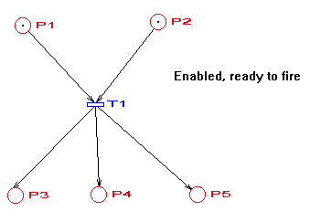
Enabled Transitions and Firing
A transition is enabled when the number of tokens in each of its input places is at least equal to the arc weight going from the place to the transition.
An enabled transition may fire at any time.

Slide 18
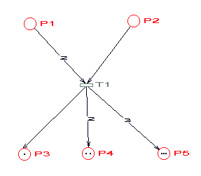
When Arcs have Different Weights…
When fired, the tokens in the input places are moved to output places, according to arc weights and place capacities.
This results in a new marking of the net, a state description of all places.
.
2
3
2

Slide 19
Inhibition
P1
P2

Slide 20
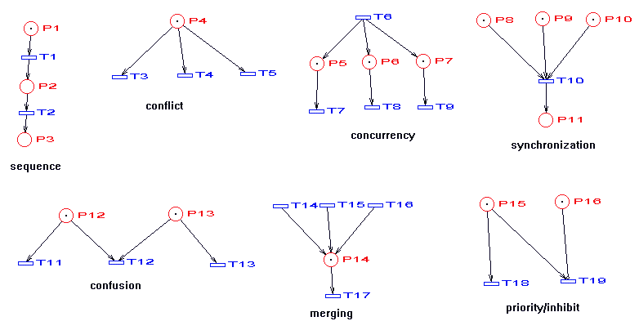
A Collection of Primitive Structures that Occur in Real Systems

Slide 21
Re-cap, Petri-Nets invented for Chemistry
Oxygen
Hydrogen
2

Slide 22
Why use Petri Nets?
Petri nets are non-deterministic and thus may be used to model discrete distributed systems.
There may be several arcs which can fire and we do not know in which order this will happen..
There have been many variations and extensions of Petri nets to more effectively model a wider variety of systems.
Since Petri nets have a rigorous mathematical notation, many questions about a system may be verified by studying properties of the Petri net. We shall study them more next lecture.

Slide 23
Semantic Data Models
Used to describe the logical structure of data processed by the system
Entity-relation-attribute model sets out the entities in the system, the relationships between these entities and the entity attributes
Widely used in database design. Can readily be implemented using relational databases
No specific notation provided in the UML but objects and associations can be used
Class diagrams show some of the same ideas

Slide 24
Software Design Semantic Model

Slide 25
Data Dictionary Entries
A Data dictionaries is a list of all of the names used in the system models.
Descriptions of the entities, relationships and attributes are also included
It may be used for name-management so that all names used in a system are consistent and do not clash
It serves as a store of organisational information so that all data is stored in one location.
On the next slide we shall see an example of a data dictionary..

Slide 26
Data Dictionary Example

Slide 27
Object Models
Object models describe the system in terms of object classes
An object class is an abstraction over a set of objects with common attributes and the services (operations) provided by each object
Various object models may be produced
Inheritance models
Aggregation models
Interaction models

Slide 28
Object Models
Natural ways of reflecting the real-world entities manipulated by the system
More abstract entities are more difficult to model using this approach
Object class identification is recognised as a difficult process requiring a deep understanding of the application domain
Object classes reflecting domain entities are reusable across systems

Slide 29
The Unified Modelling Language
Devised by the developers of widely used object-oriented analysis and design methods
Has become an effective standard for object-oriented modelling
We will study UML in more detail in later lectures
For now, note that UML is an expressive, easy to use, unambiguous and widely used modeling language which is well supported by a variety of suitable tools (both proprietary and open source CASE tools).

Slide 30
The Unified Modeling Language
The unified modeling language contains many different types of diagram we may use to model systems, for example:
Use-case diagrams
Class diagrams
Sequence diagrams
Statechart diagrams
Deployment diagrams
Etc.

Slide 31
The Unified Modeling Language
Notation for UML Class Diagrams:
Object classes are rectangles with the name at the top, attributes in the middle section and operations in the bottom section
Relationships between object classes (known as associations) are shown as lines linking objects
Inheritance is referred to as generalisation and is shown ‘upwards’ rather than ‘downwards’ in a hierarchy

Slide 32
Lecture Key Points
Semantic data models describe the logical structure of data which is imported to or exported by the systems.
Object models describe logical system entities, their classification and aggregation.
Sequence models show the interactions between actors and the system objects that they use.
Structured methods provide a framework for developing system models.
Next lecture: an in-depth look at Petri nets.

